Slide 1
VENTURE CAPITAL: what does investing in sovereignty really mean?
Stephen Nundy
Investment Partner and CTO

Slide 2
RECAP: EUROPE HAS ARRIVED

Slide 3
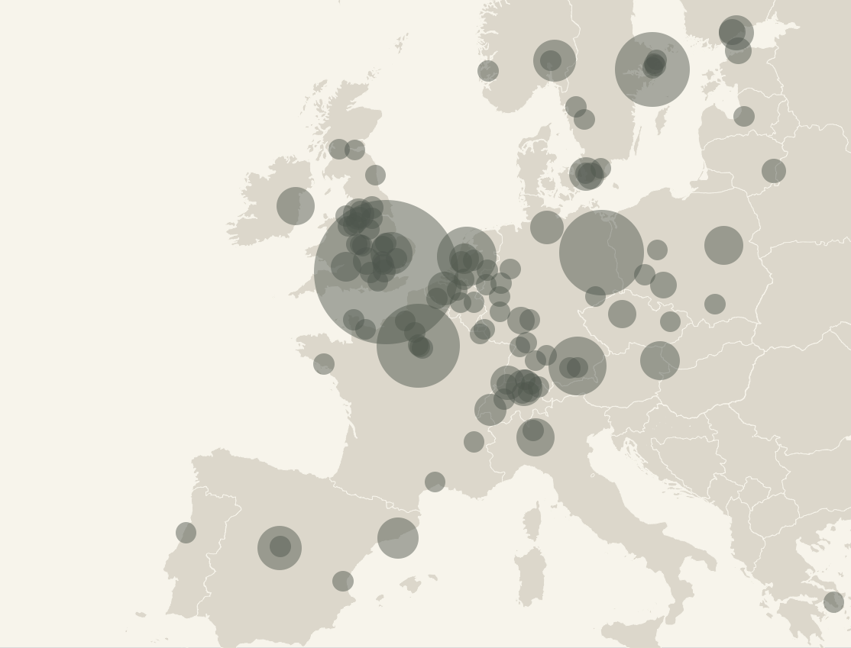
Europe has grown up…
EUROPEAN COMPANIES >$1BN VALUATION
Over 350+ unicorns spread across 100+ cities
Global technology elite are hoping to compete in Europe
European governments and universities have identified technology as mission critical
Over 100 local Seed VCs have emerged across Europe
321
VC-backed
25
2010+
2020+
Source: Dealroom.co
Notes:
European Unicorns (Dealroom report available on BOX) -- https://lakestar.box.com/s/fyek44m8u1dibqqfgi9y2f2pvvv7p6nq

Slide 4
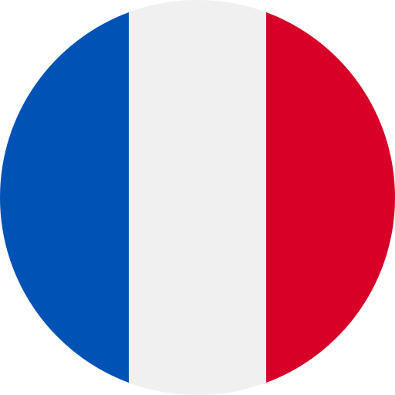
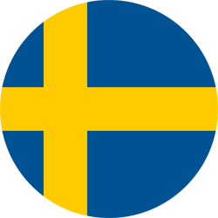
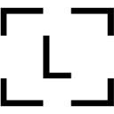
Europe is home to over 350+ unicorns cumulatively
Other countries

Slide 5
Europe is showcasing the attributes that made Silicon Valley great: Talent, capital and ambition
Europe has a pool of top talent
Significant government programs
supporting innovation
Success breeds more success
EUROPE’S TOP 10 UNICORN UNIVERSITIES
Number of unicorns
EUROPE’S TOP SPIN-OUT UNICORNS
Number of spin-outs per company
Criteo
Delivery Hero
Spotify
N26
Revolut
Klarna
BlaBlaCar
Skype
Zalando
Wise
Glovo
Deliveroo
Monzo
King.com
Babylon
iZettle
Celonis
SumUp
Wefox

Slide 6
MACRO shifts

Slide 7
Technology has decimated companies and entire industries
SHARE PRICE 2007 vs. 2023
107€
292€
377€
vs.
vs.
vs.
vs.
vs.
10€
11€
19€

Slide 8
Tech dependence will be overwhelming – the story 3 years ago…
Early algorithms
Google search, Facebook news feed
Big Data
Tailored services, predictive analytics
Perceived dependence on technology
WE WERE HERE
PERCEIVED vs. ACTUAL DEPENDENCE ON TECHNOLOGY

Slide 9
Tech dependence is accelerating – the exponential age
Actual dependence
Early algorithms
Google search, Facebook news feed
Big Data
Tailored services, predictive analytics
Powerful AI
"Social Score“ for everyone
Point of no return
Existential impact on society
Perceived dependence on technology
WE ARE HERE 2023
WE WERE HERE 2020
PERCEIVED vs. ACTUAL DEPENDENCE ON TECHNOLOGY

Slide 10
The world is divided again between two sides
GLOBAL DISTRIBUTION OF THE 100 MOST VALUABLE TECH COMPANIES
EUROPE
Europe and Southeast Asia
50:50 dependent on US and China
(there is no right choice)
Source: European Center for Digital Competitiveness
Notes:
SN

Slide 11
DIGITAL INFRASTRUCTURE
€ 30 bn
TRADE DEFICIT
Notes:
https://www.blackrock.com/corporate/literature/whitepaper/viewpoint-addressing-market-liquidity-euro-corporate-bond-market-2016.pdf

Slide 12
DIGITAL INFRASTRUCTURE
PAYMENT INFRASTRUCTURE
€ 30 bn
€ 39 bn
TRADE DEFICIT
CREDIT CARD FEES
Notes:
https://www.blackrock.com/corporate/literature/whitepaper/viewpoint-addressing-market-liquidity-euro-corporate-bond-market-2016.pdf

Slide 13
DIGITAL INFRASTRUCTURE
PAYMENT INFRASTRUCTURE
CAPITAL MARKETS INFRASTRUCTURE
€ 30 bn
€ 39 bn
€ 30 bn
TRADE DEFICIT
CREDIT CARD FEES
FEES COLLECTED BY FOREIGN BANKS
Notes:
https://www.blackrock.com/corporate/literature/whitepaper/viewpoint-addressing-market-liquidity-euro-corporate-bond-market-2016.pdf

Slide 14
Attention has also become critical infrastructure
Direct communication, no gatekeepers
Curated news feeds shaping our opinions
Artificial intelligence shaping our perception
Technology platforms have delivered the prerequisites for populism

Slide 15
Today's youth constantly influenced through technology
Parallelen zu politik:
Social media time spent (bestehende slides)
3+ hours
13,140 h
7.1 years
Daily social media usage (European average)
By the time they complete university studies
equivalent of office working hours

Slide 16
Digital platforms have become the infrastructure for our daily life
Communication
Buying behaviour
Traffic flows
Health behaviour
Media consumption
NONE OF THESE ARE EUROPEAN

Slide 17
Europe has no influence on the world‘s dominating digital platforms
132
$62bn
Top 20 digital platforms:
INVESTMENT
ROUNDS >$10MN
AVERAGE OWNERSHIP
CAPITAL INVESTED
Involvement:
14
1.98%
1.44%

Slide 18
Money needs to be invested
To gain political independence on global markets and offset economic substitution on domestic markets
Compute
pharma
space
AI

Slide 19
Now is the ideal time to invest in venture, benefiting from low valuations and a well-timed exit horizon along the market cycle
Exit window Actively drive liquidation opportunities
WE ARE
HERE
Investments Enter at attractive valuations
RECESSION
RECOVERY
UPGRADES
BOOM
PEAK
Markets
Rolling over
Bottom
Bullish, rising
Rapid gains
Peaking
Valuations
Fall rapidly
Trough
Rise to mid-cycle
Above average
Cycle highs
AVERAGE MARKET CYCLE 6-8 YEARS

Slide 20
Opportunity for new funding sources to participate in Europe remains
INSTITUTIONAL INVESTORS DOMINANT
PRIVATE CAPITAL DOMINANT BUT TIMES ARE CHANGING!
Pension funds
Insurance companies
Pension funds
Insurance companies
Family Offices
Family Offices
VENTURE CAPITAL FUNDS
VENTURE CAPITAL FUNDS
High Net-worth Individuals
High Net-worth Individuals
Endowments
State funds
Endowments
State funds
Notes:
SN

Slide 21
Entrepreneurs FOCUSED on sovereignty require local backing
Industrial Expertise
Governance
control
PATIENT CAPITAL
DEEP NetworkS

Slide 22
The time is now to invest in Sovereign Infrastructures
Benefitting from low valuations and a well-timed exit horizon
Strong pipeline of high-quality growth targets
The European ecosystem is mature but under-financed
We are finally awake to the need

Slide 23
The time is now.

